Slide 1
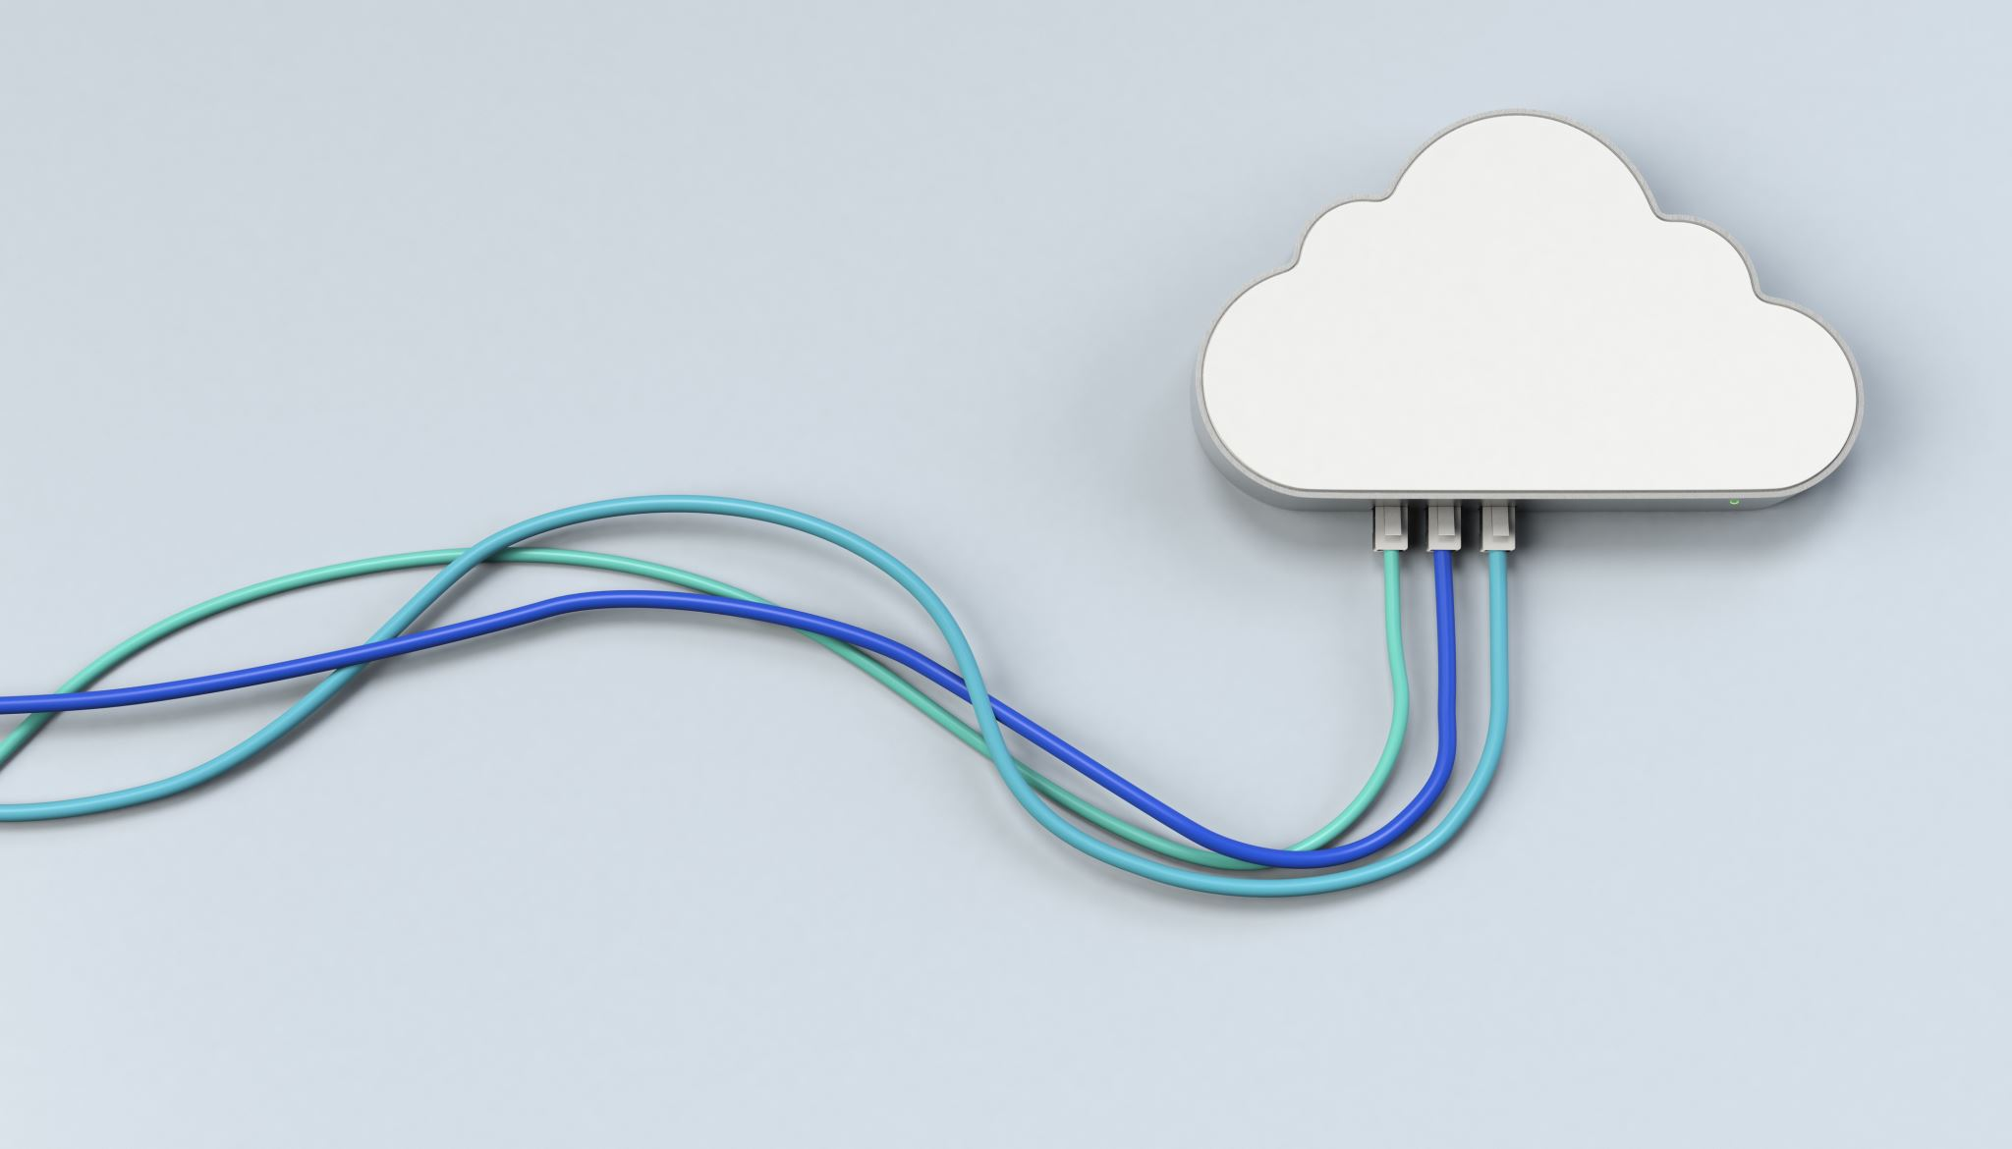
Introduction to Cloud Computing
Week 15
Service Oriented Architecture & Content Delivery Networks
CS-4037
Muhammad Sudais
muhammad.sudais.v@nu.edu.pk

Slide 2
CHAPTER 12 Service Oriented Architecture
|Cloud Computing

Slide 3
SOA (Service-Oriented Architecture): INTRODUCTION
A design pattern where software components (services) are designed to provide specific functionality.
Focuses on defining services that can be accessed over a network
Allowing for communication and integration across different systems.
Aimed at breaking down applications into smaller, reusable components (services) to increase efficiency and scalability.

Slide 4
Principles of SOA
Loose Coupling:
Services should operate independently from each other with minimal dependencies.
Loose coupling allows for flexibility in how services are composed and modified without disrupting the entire system.
Interoperability:
SOA enables different platforms, technologies, and systems to communicate and interact seamlessly.
Discoverability:
Services are registered and can be discovered dynamically by consumers to interact with them.
Reusability:
Services are designed to be reused across different applications and business processes.
Composability:
Services can be combined together to create complex business processes or solutions.

Slide 5
Why SOA?
Challenges in Traditional Systems:
In traditional systems, applications are monolithic and tightly integrated, making changes and scaling difficult.
SOA offers a solution to these challenges by creating smaller, more manageable components (services) that are loosely coupled and can be easily modified or replaced.
Business Benefits:
SOA supports rapid application development and deployment by allowing services to be reused.
Reduces redundancy and improves efficiency by providing well-defined services that can be shared across the organization.
Promotes agility and faster response to business changes.

Slide 6
Goal of System Designing
Two Primary Goals: Decoupling & Composability
Decoupling:
Tight coupling complicates system changes, while decoupling allows for greater flexibility.
SOA allows for easy integration or removal of services, improving system flexibility and reducing maintenance costs.
Composability:
Design Principle:
A composable system is built by assembling independent components to meet specific business needs.
Components should be modular, stateless, and reusable.
Key Characteristics of Composable Components:
Modular: Components are self-contained and replaceable.
Stateless: Services operate independently, without maintaining state between transactions.
SOA allows the composition of services to create complex, customized systems, enhancing system flexibility and functionality.

Slide 7
Service Represents Business Functionality
Business Analogy:
Just as businesses provide services (e.g., medical, transport), SOA services represent business functions that deliver value.
Businesses decompose their operations into specialized services, and software systems similarly use services to encapsulate specific functions.
A Service in SOA:
Provider: The entity responsible for building and managing the service.
Consumer: The entity that uses the service based on the service contract.

Slide 8
Elements of a Service
Key Components:
Contract: Defines the service’s offerings, expected outcomes, and constraints.
Interface: Specifies how the service can be accessed and interacted with.
Implementation: The internal workings of the service, hidden from consumers.
Service Registry:
A centralized directory that stores service information such as availability, usage instructions, and dependencies.
Regular updates with new services and interfaces ensure accurate discovery and usage.

Slide 9
Service Implementation Approaches
Top-Down Approach:
Service interface is defined first, followed by the implementation.
Ensures that services adhere to a contract before the actual development begins.
Bottom-Up Approach:
Service implementation exists before the interface.
Easier but may lead to a mismatch between the interface and the implementation.
Meeting in the Middle Approach:
A hybrid approach combining both top-down and bottom-up methodologies.
Ensures complete control over interface definition, especially when the implementation is already in place.

Slide 10
Attributes of Services
Self-Contained: Services should ideally operate independently, though they may have some dependencies.
Coarse-Grained: Services should be larger in scope to improve performance and security.
Stateless: Services should not maintain state between transactions, making them easier to manage.
Reusable: Services should be designed for reusability across different applications and business functions, avoiding redundancy.

Slide 11
Open Standard Implementation
Open standards are key to SOA, making it easier to implement and integrate services using industry-standard protocols and technologies.
Key Open Group Standards:
SOA Reference Architecture.
SOA Governance Framework.
Service-Oriented Cloud Computing Infrastructure (SOCCI).
Message Exchange & Service Description Technologies:
XML: Used for message exchange in SOA, providing a flexible, platform-independent format.
WSDL (Web Services Description Language): Defines service interfaces using XML, enabling service discovery.
SOAP (Simple Object Access Protocol): A protocol for exchanging messages between services over a network, independent of platforms and languages.
UDDI (Universal Description, Discovery, and Integration): A directory for registering and discovering services via WSDL and SOAP.

Slide 12
Benefits of SOA : Architectural Benefits
Flexibility: Easier to change or update services without affecting the whole system.
Reusability: Services can be reused across various applications, reducing development time and cost.
Simplified Integration: SOA makes it easier to integrate different systems by using well-defined interfaces, reducing complexity and improving interoperability.
Improved Scalability: Modular services can be scaled independently, optimizing resource utilization.

Slide 13
Benefits of SOA : Business Benefits
Agility: Service-orientated architecture is based on the assumption that system changes over time. Hence, a well-designed SOA-based development protects a system from the impact of this evolution. The flexibility of SOA enables a system to respond quickly to new requirements.
Cost reduction: Services once developed can be reused by disparate systems for different kind of purposes. Integration of services in a system is also easy. Therefore, the reuse of already existing assets (services) makes it cheaper as reusability means lower development and testing cost.
Increase in quality: Reuse of a service by multiple consumers make a service well tested and flawless. Its quality improves and thus SOA provides high performance and delivers good return-on-investment (ROI).
Quicker release to market: Service-oriented approach takes lesser time for system development or even for a system up-gradation. It thus makes the launch of a system quicker to market by diminishing the development time.
Standardization: Services in SOA are generally developed following open standards. This standardization makes services more vendor-independent and any kind of system can use a service as long as it uses the proper (standard) service interface.

Slide 14
SOA AND CLOUD COMPUTING
Common Goals: Both aim to improve system agility and flexibility through service reuse and distributed software assets.
Key Differences:
SOA: An architectural approach for designing reusable services.
Cloud Computing: Provides on-demand access to computing resources and services.
Provider-Consumer-Broker Model: Both follow the provider-consumer-broker interaction model for service delivery and consumption.
Both promote the reuse of services and minimize dependencies (loose coupling) to optimize resource utilization.
SOA's Role in Cloud: Cloud services are structured using SOA principles. They complement each other for optimal performance, with SOA organizing cloud services effectively.
SOA applications can run on traditional servers as well as cloud environments.
SOA at the Cloud's Top Layer: SOA is critical for the Software-as-a-Service (SaaS) layer, structuring software services within cloud infrastructure.
Adapting SOA for Cloud Consumers: To fully benefit from cloud computing, consumers should adapt SOA as their application architecture.

Slide 15
CHAPTER 11 Content Delivery Networks
|Cloud Computing

Slide 16
What is CDN?
Definition: A system of distributed servers ensuring fast and efficient delivery of web content.
Purpose:
Minimize latency.
Enhance speed and reliability.
Improve user experience.
Key Features:
Content is delivered from the closest server to the user.
Reduces the load on central servers by using edge servers.

Slide 17
Why Use a CDN?
Improved User Experience: Faster loading times enhance user satisfaction.
Global Availability: Ensures high availability regardless of user location.
Resource Optimization: Reduces load on central servers by utilizing edge servers.
Support for Scalability: Handles increased user traffic without degradation in performance.

Slide 18
How CDN Works?
Caching Mechanism: Content is stored on geographically distributed edge servers.
Request Redirection: Users are directed to the nearest server, minimizing delays.
Load Balancing: Distributes traffic across multiple servers to prevent overload.

Slide 19
Types of Content Delivered via CDN
Static Content: Images, JavaScript, CSS files, etc.
Dynamic Content: Videos, audio, live streaming.
Web Applications: APIs and interactive content for better performance.
Software Downloads: Large software packages, updates, and patches.

Slide 20
Advantages of CDN
Accommodating Heavy Traffic: Distributes traffic across multiple servers, ensuring smooth operations during high demand.
Support for More Simultaneous Users: High data thresholds enable support for large user bases simultaneously.
Reduced Load on Servers: Balances content delivery tasks among servers, enhancing server efficiency.
Faster Content Delivery: Reduces travel distance for data, enabling quicker content delivery.
Lower Cost of Delivery: Efficient routing and edge caching reduce operational costs.
Controlling Asset Delivery: Monitors content demand and network load to allocate resources effectively.
Facilitates Scalability: Expands delivery systems horizontally to maintain performance during spikes.
Better Security: Replicated content across servers ensures recovery in case of failures or disasters.

Slide 21
Disadvantages of CDN
New Points of Failure: Dependency on the CDN provider introduces risks during provider outages.
Additional Content Management Tasks: Requires content updates and management through the CDN provider’s infrastructure.

Slide 22
CDN Service Providers
Akamai:
Founded: 1998, Cambridge, USA; Largest CDN with 100,000+ servers.
Clients: Facebook, Twitter, ESPN, BBC iPlayer, Yahoo.
Limelight Networks:
Founded: 2001, Arizona, USA; Offers global high-bandwidth content delivery.
Amazon CloudFront:
Launched: 2008; Pay-per-use model; 50+ global edge locations.
Azure CDN:
Launched: 2010; Utilizes Microsoft Azure's global data centers.
CDNetworks:
Founded: 2000, Korea; Offices in Korea, US, China, UK, Japan.

